Slide 1

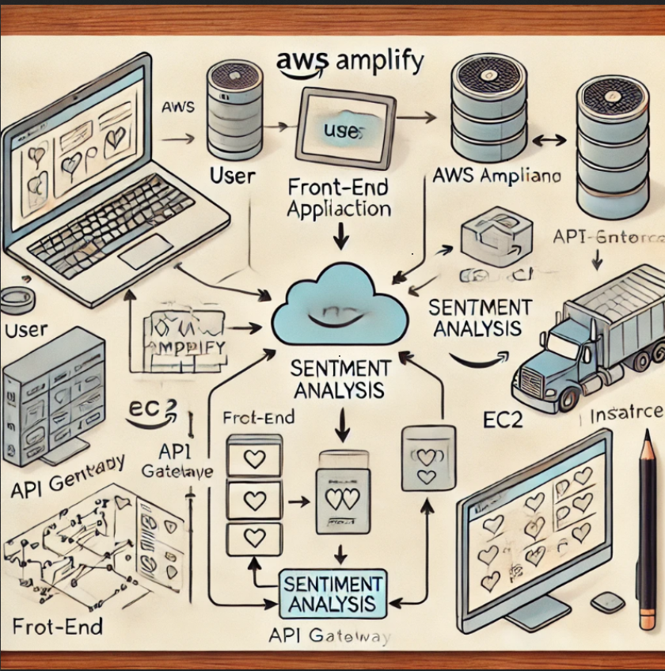
Sentiment Analysis Application on AWS Senti-bot
GrOUP CC- FALL2024 12
Members - Nihar domala, Aravinda v., sailesh baabu s.
Professor - Dr. Walcelio Melo

Slide 2
Objectives
Develop a web application that performs sentiment analysis and emotion dection on user-provided text/files.
Utilize pre-trained huggingface machine learning models.
Provide an intuitive user interface (UI) for text input and result display.
Ensure scalability, security, and cost-effectiveness.

Slide 3
Use-Cases
Customer Feedback Analysis - Analyze feedback from customer reviews, surveys, and support tickets to gauge customer sentiment.
Market Research- Analyze user opinions and sentiments on new product features, services, or campaigns.
Social Media Monitoring- Monitor social media platforms like Twitter, Facebook, and Reddit to assess public sentiment around brands, products, or trending topics.
Content Moderation- Automatically filter or flag content that contains negative, offensive, or inappropriate language on platforms that rely on user-generated content.

Slide 4
Features Implemented
1. User Interface (UI)
Text input area for users to enter sentences or paragraphs. Submit button to initiate sentiment analysis.
Display area for showing sentiment results (Positive, Negative, Neutral).
2. Backend API
Develop a RESTful API to handle requests from the frontend. Process user input and return sentiment analysis results.
3. Custom Sentiment Analysis Model and Emotion Detection
Use a pretrained model fine-tuned on a sentiment dataset and on a emotion detection dataset.
Deploy the model as a SageMaker endpoint.
4. Scalability and Performance
Optimize the application for low latency and high throughput.

Slide 5
Data Sources and Tech Stack
Pretrained Models:
Hugging Face Transformers Library
Models like distilBERT-base-ubcased-finetuned-sst-2-english for Emotion Detection and BERTweet for Sentiment Analysis
Tech Stack:
Frontend- React, Backend- Java Script
AWS Services – SageMaker, Lambda, API Gateway and Amplify
Libraries- Hugging Face

Slide 6
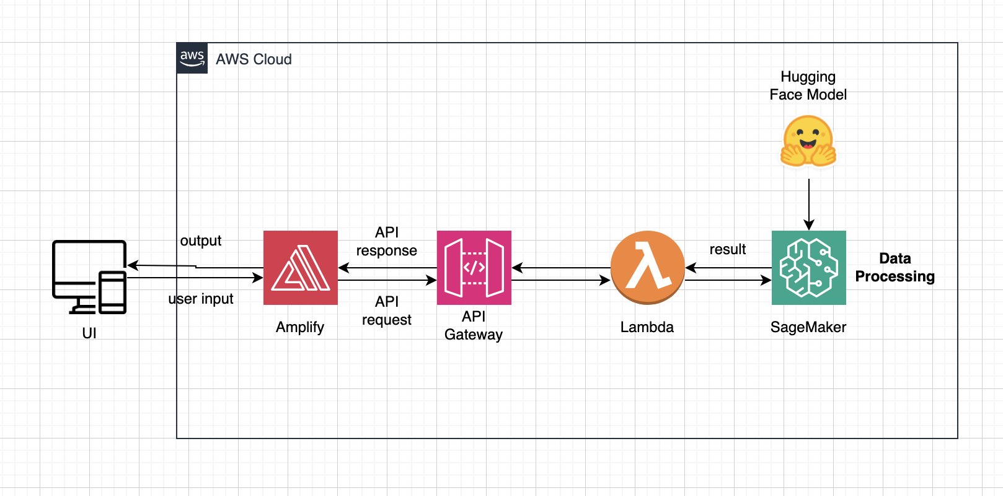
Project Architecture

Slide 7
AWS Amplify and Front-End
AWS Amplify Hosting: AWS Amplify manages the deployment and hosting of the front-end application, providing a scalable environment with direct integration into other AWS services.
User Interaction: The front-end, built with React, offers an interactive user interface where inputs for sentiment analysis are collected and results displayed, enhancing user engagement.

Slide 8
API Gateway and Lambda Integration
API Gateway Management: Amazon API Gateway handles routing of API requests to the correct AWS Lambda functions, ensuring efficient processing and scalability during varying load conditions.
Lambda Processing: AWS Lambda functions execute the application's backend logic, interacting with the SageMaker-hosted model to perform sentiment analysis and returning the results in real-time.

Slide 9
Amazon SageMaker and Hugging Face
Model Deployment: Amazon SageMaker hosts and runs the Hugging Face machine learning model, providing a robust and scalable platform for complex computations required for natural language processing.
Integration and Response: SageMaker processes the text data received from Lambda, applying the pre-trained Hugging Face model to determine sentiment, and sends the analyzed results back through Lambda, ensuring quick and accurate sentiment analysis outputs.

Slide 10
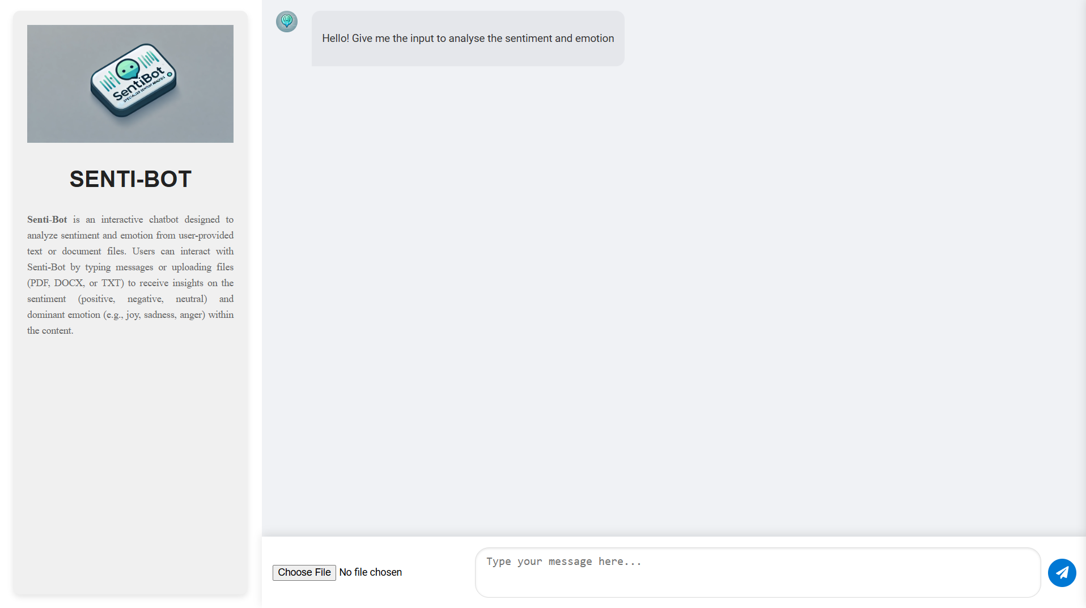
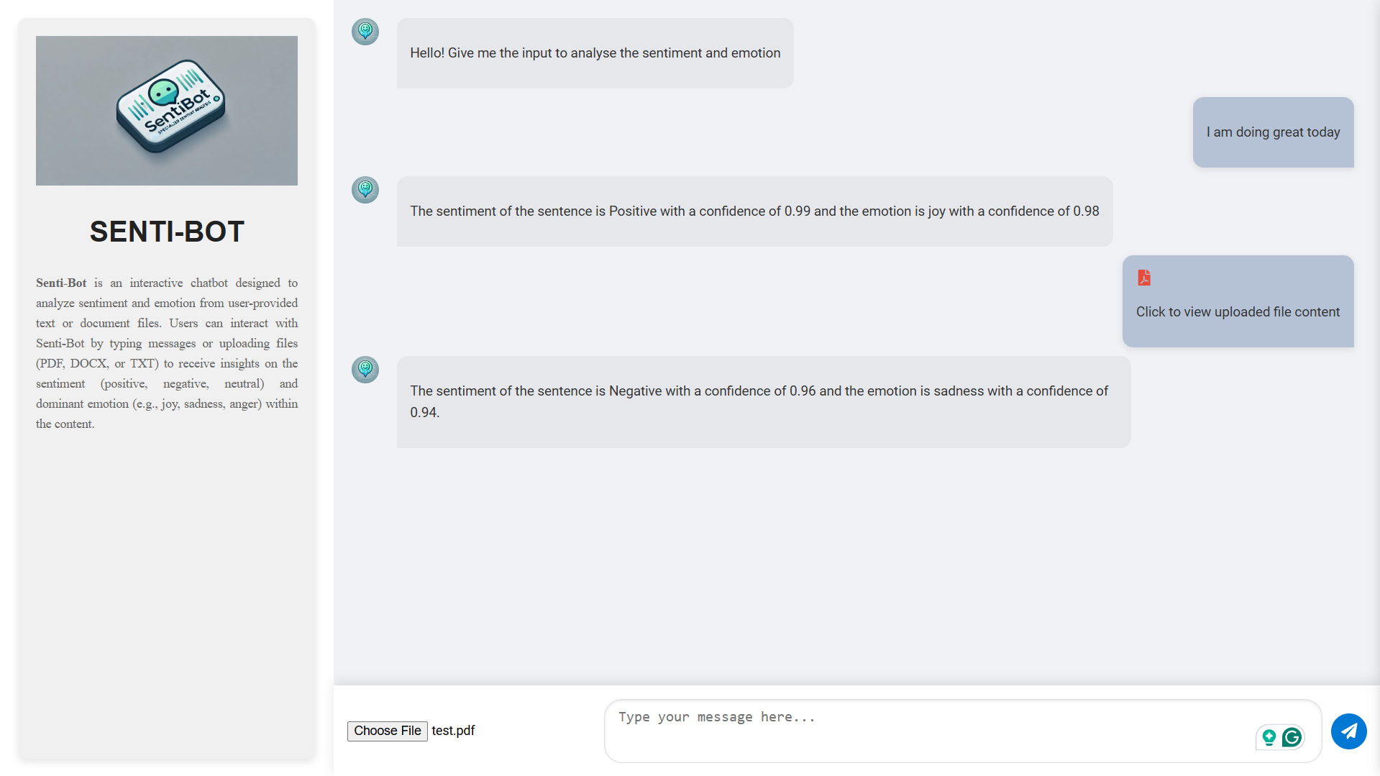
Demo
SentiBot

Slide 11
Future Scope (SENTI-BOT 2.0?)
Chatbots: Integrate an interactive chatbot using AWS Lex to answer user queries, provide guidance, or simulate conversational interactions.
Topic Analysis: Identify prevalent topics or themes within user text to gain deeper insights into user concerns and interests.
Sarcasm and Irony Detection: Enhance analysis accuracy by detecting sarcasm, irony, or nuanced sentiments often missed in traditional models.
Multilingual Support: Enable sentiment and emotion analysis across multiple languages to cater to a broader, diverse user base.
User Accounts & Personalization: Allow users to create accounts using Cognito and save their interaction history, which can be stored in DynamoDB for future reference and personalization.

Slide 12
Conclusion
Successfully developed and deployed a sentiment analysis application on AWS with emotion detection as an additional feature.
Demonstrated proficiency in cloud architecture and machine learning with AWS SageMaker and integrating various services.
Achieved a scalable and efficient model deployment, ensuring responsive and seamless user interactions.
Overall, created a cost-effective, impactful solution that can serve as a foundation for further innovation in sentiment analysis and other simple chatbots.

